Slide 1
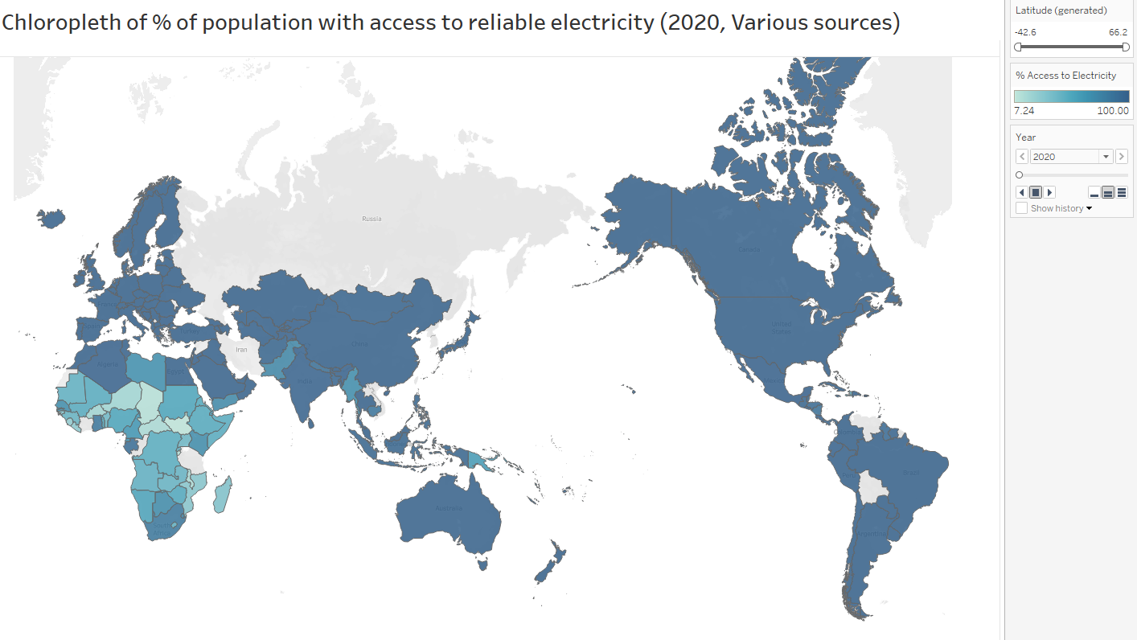
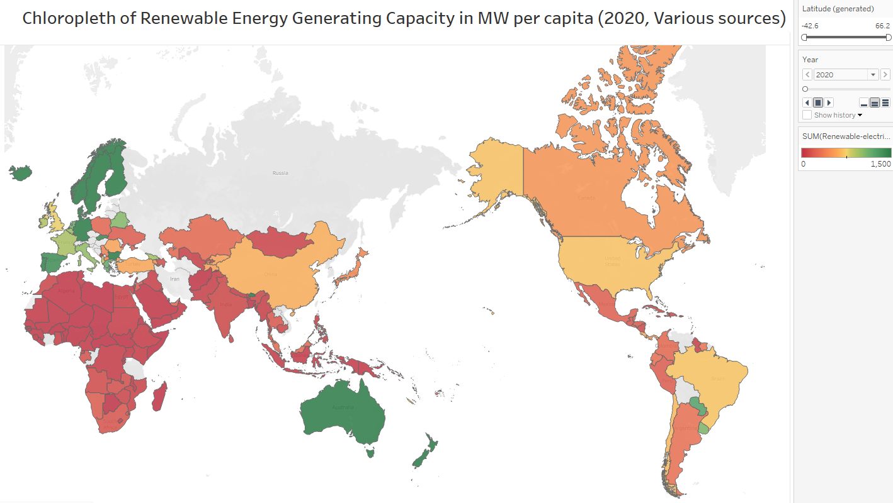
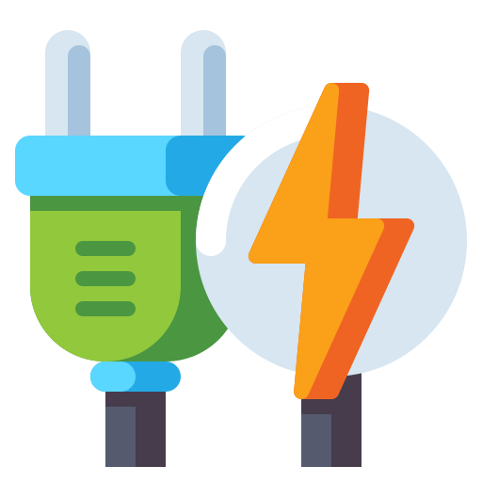

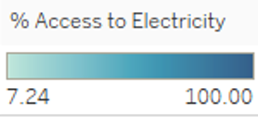
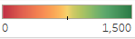
Global distribution of energy is highly unequal, and renewable capacity per capita is spotty at best
+
Three-Quarters of those without electricity are in Africa
Consequences of material poverty
Africa makes up only 2% of global renewable energy capacity.
Notes:
Extreme poverties have led to Africa housing 3 quarters of the unelectrified and only 2% of global renewable energy grids which structurally embeds distributional inequalities. Other regions of concern include small island developing States and miscellaneous Asian countries.

Slide 2
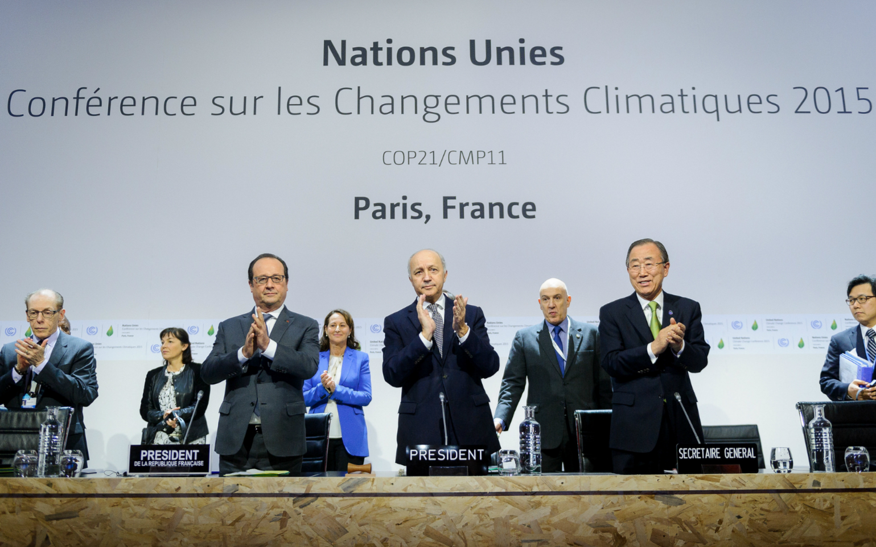
Blunt Instrument
Notes:
With net-zero emission targets gaining traction such as the Paris Agreement, blunt instrument approaches | to spur renewables

Slide 3
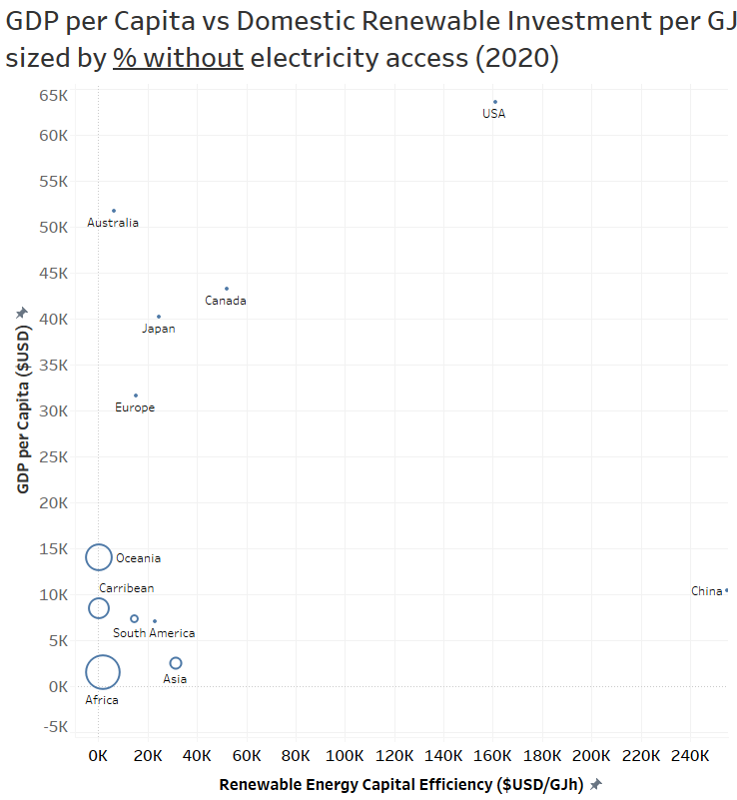
Plethora of investment risks structurally increase barrier to renewables
Advanced economies
Can self-sustain renewables due to wealth, stability, industry and resources.
Low levels of energy inaccess.
Notes:
to spur renewables is an uphill battle for the energy poor, who | face up to a

Slide 4
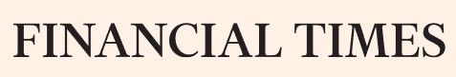
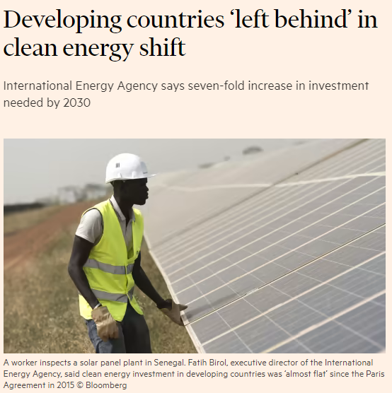
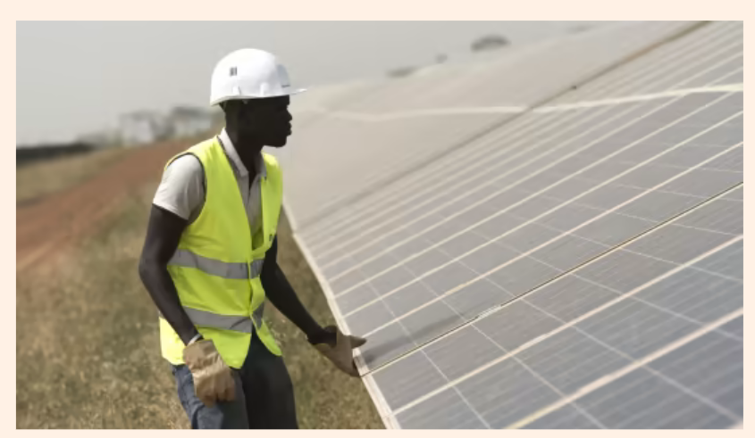
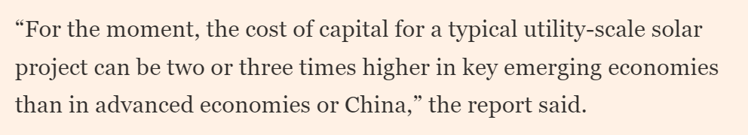



Plethora of investment risks structurally increase barrier to renewables
Advanced economies
Can self-sustain renewables due to wealth, stability, industry and resources.
Low levels of energy inaccess.
IEA report 2019
Notes:
tripled cost of capital for investment, | poor infrastructure

Slide 5




Plethora of investment risks structurally increase barrier to renewables
Investment Risks
Caribbean and Pacific
Difficult to mobilise physical capital and sparse natural resources for infrastructure.
Examples: Tonga, Vanuatu, Trinidad
Advanced economies
Can self-sustain renewables due to wealth, stability, industry and resources.
Low levels of energy inaccess.
Asia and Central/South America
Corrupt governance, civil strife and low capital/financial/fiscal credibility, political instability
Examples: Afghanistan, Venezuela, Brazil
Africa
Poor infrastructure and manufacturing, materially poor in wealth and corrupt governance
Contains 75% of people without electricity
Examples: Chad, DRC, Nigeria, Angola
IEA report 2019
Notes:
poor infrastructure and governance, lackluster manufacturing, poverty and mobility hurdles, causing a perception of risk.

